Slide 1
EMBARK matchmaker
https://my.embarkvet.com/members/breeder-tools
Introduction to accessing and using the EMBARK matchmaker tool for breeders

Slide 2
First things first!
Make your Stabyhoun’s basic information available to the public. This way, the breeder tool is most effective!
Log into Embark:
https://my.embarkvet.com/members
1. Select “BREEDER TOOLS” by clicking on that area
2. Select “DOG SETTINGS”
3. Set privacy settings to “PUBLIC” by clicking on each box under “Matchmaker”, “Breed”, “Health”, “Traits”
4. SAVE your selections!

Slide 3
2. Select “DOG SETTINGS” by clicking on that area

Slide 4
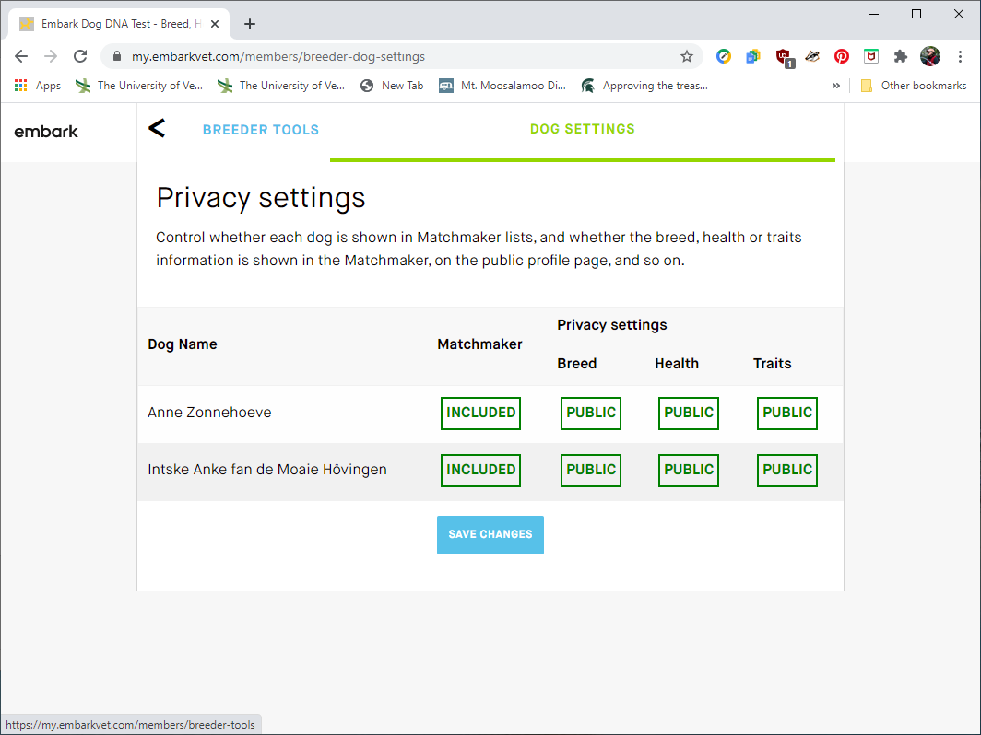
Next Step…
SAVE YOUR CHANGE TO “PUBLIC”
From the “DOG SETTINGS” screen, after you made your Stabyhoun “public”…
Click on “BREEDER TOOLS” to get back to the action!

